Slide 1


CHM 103 ORGANIC CHEMSTRY I
Department of Chemical Sciences
Faculty of Science and Technology
Bingham University, Karu
Course Lecturer: Joseph C. Oguegbulu
Joseph.oguegbulu@binghamuni.edu.ng

Slide 2
COURSE CONTENT
PART A – Mr. Joseph
Introduction. History, classifications 0.5 week
Carbon: Bonding in organic compounds, structure 0.5 week
Functional groups 0.5 week
IUPAC nomenclature 1 week
Isomerism – Structural & Stereo-isomerism 2 weeks
Hybridisation – Resonance effects & others 2 weeks
PART B – Assoc. Prof. Okoli
Alkanes, Alkenes, Alkynes
Alkyl halides, Alkanols
Carbonyl compounds: Alkanals and Alkanones.

Slide 3
CHM 103 ORGANIC CHEMSTRY I
Department of Chemical Sciences
Faculty of Science and Technology
Bingham University, Karu
Course Lecturer: Joseph C. Oguegbulu
Joseph.oguegbulu@binghamuni.edu.ng

Slide 4
LECTURE IX
HYBRIDISATION OF CARBON
sp³
sp²
sp
ELECTRONIC CONFIGURATION
ORBITALS
SIGMA BONDS VS PI-BONDS

Slide 5

OBJECTIVES: At the end, you should be able to…
Write the electronic configuration of simple atoms including Carbon
Explain hybridisation using carbon
Differentiate between an atomic orbital and a molecular orbital
Identify & explain d/f hybridisation types in simple moleucles
Differentiate between sigma bonds and pi bonds

Slide 6
WHAT IS AN ORBITAL
An orbital is a mathematical approximation of the region in space where there is the highest probability of finding an electron at any given point in time
An atomic orbital is an orbital of electrons associated with an atom of a free element
Molecular orbital belongs to molecules formed by the atoms

Slide 7

ELECTRONIC CONFIGURATION
Recall
Principal quantum number (n) 1,2,3,4,5...etc
Azimuthal quantum number (l) s,p,d,f
Spin quantum number (m_{s}) +1_{/2} or -1_{/2}
Magnetic quantum number (m_{m}) -l...0...+l
More in CHM 102
Shapes of orbitals

Slide 8
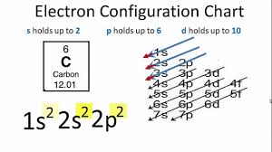
ELECTRONIC CONFIGURATION
D

Slide 9
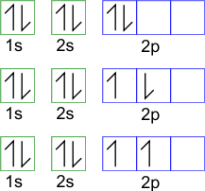
ELECTRONIC CONFIGURATION: Rules
Aufbau principle
Hund’s Rule
Pauli’s exclusion principle

Slide 10

ELECTRONIC CONFIGURATION OF CARBON
¹²₆C
i.e Atomic Number = 6; Mass Number = 12

Slide 11
ELECTRONIC CONFIGURATION: Examples
Q
Write the electronic configurations of…
N
O
S²⁻

Slide 12

QUESTIONS???

Slide 13
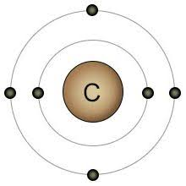
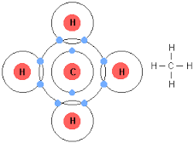
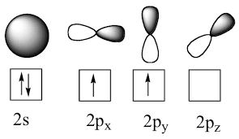
VALENCE SHELLS
Valence shell ➔ Outermost shell in an atom
Valence electrons ➔ Outermost electrons in an atom
1s² 2s² 2p²
They are the ones involved in chemical bonding
Electronic configuration of valence shell of carbon

Slide 14
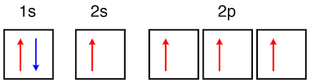
HYBRIDISATION OF CARBON
Hybridisation is the mixing of half-filled valence atomic orbitals of similar energy to form identical hybrid orbitals
But for valence shell orbitals to become all half-filled (i.e. one electron each), excitation must happen
Ground State
Becomes
1s² 2s¹ 2p³
Excited State

Slide 15
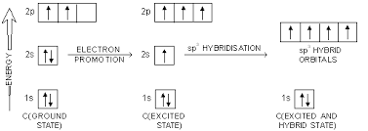
HYBRIDISATION OF CARBON
d

Slide 16


HYBRIDISATION OF CARBON
The hybrid orbitals formed are identical to one another
i.e. Same shapes, same energies
Totally d/f from the un-hybridised orbitals that formed them
Total number of hybrid orbitals formed = Total number of unhybridised orbitals mixed
Hybrid orbitals

Slide 17
HYBRIDISATION OF CARBON: Types
Hybridisation is very Important in Organic Chemistry b/c Carbon must hybridise b4 bonding
There are three (3) types! (sp³, sp² and sp hybridisations)
Depending on how may p-orbitals mixed with the ‘s’
sp³ = One s + Three p orbitals mixed
sp² = One s + Two p mixed (one unhybridised p-orbitals left)
sp = One s + One p mixed (two unhybridised p-orbitals left)

Slide 18
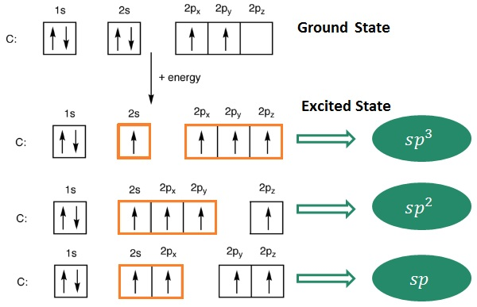
HYBRIDISATION OF C: 3 Types, sp³, sp² & sp

Slide 19
QUESTIONS???

Slide 20
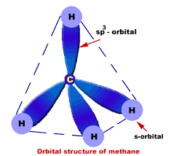
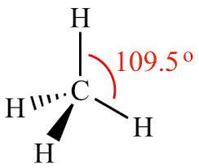
TYPES: sp³ HYBRIDISATION IN METHANE (CH₄)
d
Four (4) C-H SIGMA bonds are formed
A SIGMA BOND (σ) is formed by direct (Head to Head) overlap of HYBRIDISED ORBITALS
All single bonds are sigma bonds!!!

Slide 21
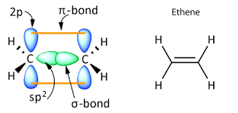
TYPES: sp² HYBRIDISATION IN ETHENE (C₂H₄)
D
1. Four (4) C-H SIGMA bonds are formed
2. One C-C sigma bond & One C-C Pi-bond
A Pi-BOND is formed by indirect (side to side) interaction of two UN-hybridised orbitals
Every double bond is made of one sigma (σ) bond & one pi-bond (π)

Slide 22
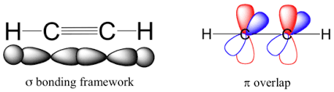
TYPES: sp HYBRIDISATION IN ETHYNE (C₂H₂)
D
Two (2) C-H SIGMA bonds are formed
One (1) C-C SIGMA bond &
Two C-C PI-bonds
Every triple bond is made of one sigma (σ) bond and two pi-bonds (π)

Slide 23
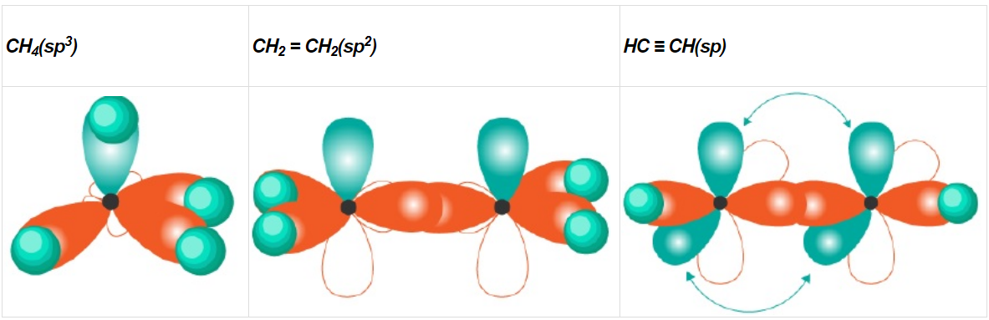
HYBRIDISATION OF CARBON: Examples
s
4 C-H sigma bonds
One C-C sigma bond, one C-C pi-bond
2 C-H sigma bonds
One C-C sigma bond, Two C-C pi-bonds
4 C-H sigma bonds

Slide 24
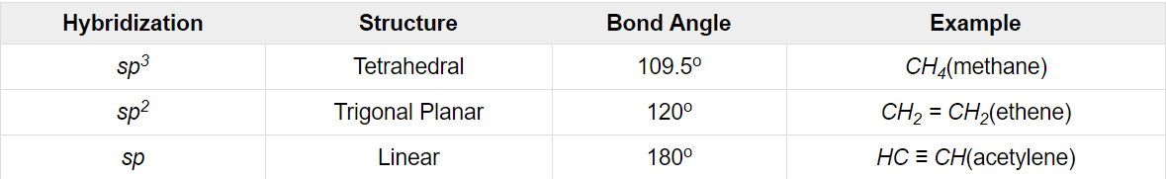
HYBRIDISATION OF CARBON: Properties

Slide 25
SIGMA (σ) BONDS vs PI (π) BONDS
Sigma bonds are stronger than pi bonds. Pi-bonds can be easily broken
Hence molecules w/ Pi-bonds are more reactive (C₂H₂>C₂H₄>C₂H₆)
2. Sigma bond can exist alone (i.e. as single bonds)
Pi-bonds only exist with a sigma bond to make double/triple bonds
Sigma bonds can be formed by both hybridized &unhybridised orbitals
Pi-bonds are only formed by unhybridised orbitals
4. Electron density in sigma bonds is within the plane of the bond
Electron density in pi bonds is above &below the plain of the bond

Slide 26
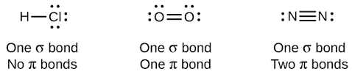
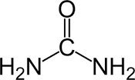


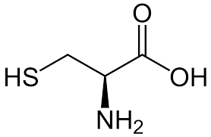

Tutorial IV
Q
Given this;
How many σ & π bonds are in the compounds below???

Slide 27
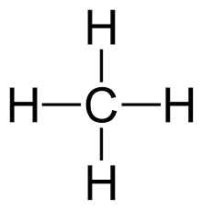
Tutorial IV
Q
Given this;
What are the hybridisation states of the Carbon atoms in these molecule?

Slide 28


